Slide 1
Research on the Issues about the Ridership of Urban Rail Transit
CHEN Qi
Graduate School of Human-Environment Studies, Kyushu University, Japan
2018.01.08

Slide 2
1. Introduction
Present Situation
Weakness in population growth
Tendency of using private transport
The financial pressure of public transport operator
Research Purpose
Explore and explain the factors influencing subway ridership
Explore the handling of small samples in this kind of issue
Research Content
Build the index framework based on prior study;
Identify the valid variables that do affect subway ridership
Estimate the Mix Geographically Weighted Regression model.

Slide 3
1. Introduction
Review
Year |  | 2004 | 2004 | 2009 | 2010 | 2011 | 2012 | 2013 | 2013 | 2015
Author |  | Chu | Kuby et al. | Taylor et al. | Sohn and Shim | Gutiérrez et al. | Cardozo et al. | Chakraborty et al. | Zhao et al. | Jun et al.
Catchment (walking distance) |  | 400m walking distance | 800m walking distance | N/A | N/A | Distance-decay 800m buffer | 800m walking distance | N/A | 800m radius | 300m,600m,900m radius
Method |  | Poisson Regression | WLS | 2SLS | OLS/SEM | OLS | OLS/GWR | OLS/SEM | OLS | OLS/MGWR
Sample Size |  | 2568 | 268 | 265 | 251 | 158 | 190 | 900 | 55 | 442
Number of Valid Indicator |  | 15 | 11 | 8 | 7 | 9 | 4 | 9 | 11 | 11
Coefficient of determination (Adjusted R²) |  | 0.54 | 0.71 | 0.91 | 0.60 | 0.73 | 0.56 | 0.69 | 0.95 | 0.77
Building environment | Built environment |  |  |  | ● | ● |  | ● | ● | ●
 | Hospital |  |  |  |  |  |  |  | ●
 | School/University |  |  |  | ● |  |  |  | ●
 | CBD |  | ● |  |  |  |  |  | ●
 | Land use mix |  |  |  | ● | ● | ● |  |  | ●
 | Other infrastructures |  | ● |  |  |  |  |  | ● | ●
Transportation Accessibility | Accessibility of pedestrian | ● |  |  |  |  |  | ●
 | Accessibility of transfer |  | ● |  | ● | ● | ● | ● | ● | ●
 | Road coverage |  |  | ● | ● |  |  |  | ●
 | Parking |  | ● |  |  |  |  |  | ●
 | Service level of public transit | ● | ● | ● |  | ● | ● |  | ● | ●
 | Locational factor |  | ● |  | ● |  |  |  | ●
Demographic and Socioeconomic Environment | Population |  | ● | ● | ● |  | ● | ● | ● | ●
 | Employment | ● | ● | ● | ● | ● | ● | ● | ● | ●
 | Age | ● |  | ● |  |  |  |  |  | ●
 | Tenant proportion |  | ● |  |  |  |  |  |  | ●
 | Race | ● | ● | ● |  | ●
 | Income | ● |  |  |  |  |  | ●
 | Vehicles holdings | ● |  |  |  |  | ● | ●
 | Fare |  |  | ●

Slide 4
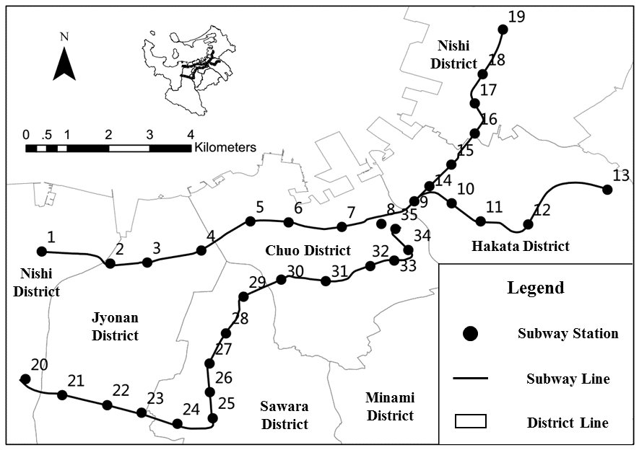
2. Study Context
Study Area
Fukuoka city
35 subway stations
3 operating subway lines
29.8 km operating mileage
20% share of motorized travel
Data Source
乗降人員
都市計画基礎調査
国勢調査
国土数値情報
数値地図（国土基本情報）
The reference year of data is set to H22

Slide 5
2. Study Context
Catchment Area of Stations
Range for general
Catchment area: walking distance accessing the subway station.
(Pedestrian Catchment Area, PCA)
Thresholds range: 400m ~ 1000m
Most adopted: 800m
Rang in Fukuoka
Walking speed: about 4.8km/h
Average walking distance is about 600m
It can be inferred that most trips can be included in the range of 800 meters in Fukuoka
 | Walking |  | Bicycle
 | Proportion | Ave time | Proportion | Ave time
Average | 78% | 7.2 | 9% | 9.0
median | 85% | 7.0 | 8% | 9.5
Max | 22% | 4.8 | 0% | 0.0
Mix | 100% | 9.2 | 33% | 20.0

Slide 6
3. Factor Influencing Subway Ridership
Variable Summary
Category | Variable | Expected sign | Min Value | Max Value | Average | Unit
Built environment | Commerce | + | 2,921 | 811,281 | 114,353 | m²
 | Office | + | 2,614 | 839,956 | 167,088 | m²
 | Residence | + | 110,748 | 1,067,523 | 528,533 | m²
 | Education | + | 294 | 305,559 | 59,691 | m²
 | Government | + | - | 128,471 | 20,878 | m²
 | Transportation Facility Area | + | 197 | 132,777 | 21,204 | m²
 | Land use Aggregation | + | 0.09 | 0.75 | 0.31 | -
Transportation Accessibility | Transfer Dummy | + | 1 | 4 | 1.34 | -
 | Bicycle Parking | Unknown | 64 | 4,375 | 778 | -
 | Bus Capacity | Unknown | 3 | 260 | 58.48 | -
 | Bus Accessibility | Unknown | 4 | 455 | 89.71 | -
 | Road Density | - | 191 | 479 | 299 | m/ha²
Demographic and Socioeconomic Environment | Population | + | 1,908 | 19,393 | 9,813 | -
 | House Member | - | 1.86 | 2.79 | 2.18 | -
 | Job-Resident Balance | Unknown | 1.27 | 2.61 | 1.80 | -
 | Tenant Proportion | - | 0.15 | 0.65 | 0.43 | %
Dependent variable: average daily subway ridership

Slide 7
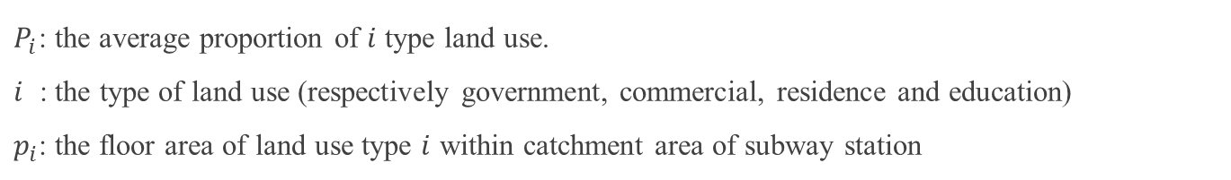


3. Factor Influencing Subway Ridership
Variable Interpretation
Land-use Aggregation
The indicator of land-use mix is re-defined into the aggregation of land-use.
Range of PCA | Residence | Office | Commerce | Education | Total
600 | 51.8% | 19.3% | 13.8% | 5.5% | 90.5%
800 | 55.3% | 17.5% | 12.0% | 6.2% | 90.9%
1000 | 57.6% | 16.5% | 10.8% | 6.0% | 90.9%
1200 | 59.2% | 15.5% | 10.2% | 5.9% | 90.8%
Ave | 62.8% | 10.1% | 7.5% | 5.3% | 85.7%
Average $P_{i}$
$G=\sqrt{\sum{{\left(p_{i}−P_{i}\right)}^{2}}}$
$P_{i}$: the average proportion of $i$ type land use.
$i$ : the type of land use (respectively government, commercial, residence and education)
$p_{i}$: the floor area of land use type $i$ within catchment area of subway station

Slide 8
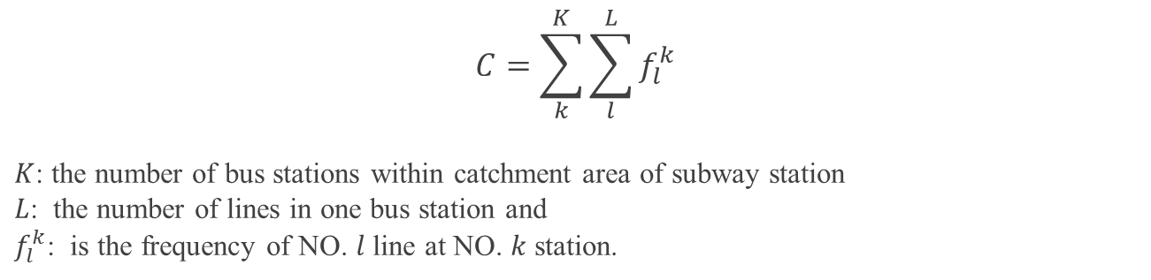
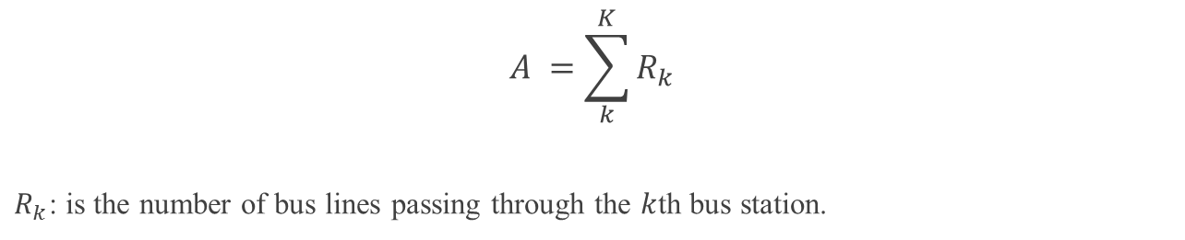
3. Factor Influencing Subway Ridership
Variable Interpretation
Bus capacity
$$C=\sum_{k}^{K}{\sum_{l}^{L}{f_{l}^{k}}}$$
$K$: the number of bus stations within catchment area of subway station
$L$: the number of lines in one bus station and
$f_{l}^{k}$: is the frequency of NO. $l$ line at NO. $k$ station.
Bus Accessibility
$$A =\sum_{k}^{K}{R_{k}}$$
$R_{k}$: is the number of bus lines passing through the $k$th bus station.

Slide 9
4. Identification of Valid Factors
Exploratory Regression – Stage 1
Category | Variable | Statistical Information
 |  | VIF | Validity | stability | times | + | -
 | Total |  |  |  | 367 | 253 | 114
Built environment | Commerce Area | 8.8 | 32.1% | 100.0% | 25 | 25 | 0
 | Office Area | 10.4 | 9.0% | 71.4% | 7 | 5 | 2
 | Residence Area | 27.5 | 12.8% | 70.0% | 10 | 7 | 3
 | Education Area | 1.8 | 7.7% | 100.0% | 6 | 6 | 0
 | Government Area | 1.8 | 42.3% | 100.0% | 33 | 33 | 0
 | Transportation Facility | 3.0 | 67.9% | 100.0% | 53 | 53 | 0
 | Land use Aggregation | 2.5 | 50.0% | 100.0% | 39 | 39 | 0
Transportation Accessibility | Transfer Dummy | 3.0 | 34.6% | 100.0% | 27 | 27 | 0
 | Bicycle Parking | 4.5 | 44.9% | 100.0% | 35 | 35 | 0
 | Bus Capacity | 6.6 | 37.2% | 96.6% | 29 | 1 | 28
 | Bus Accessibility | 6.8 | 19.2% | 100.0% | 15 | 15 | 0
 | Road Density | 2.3 | 1.3% | 100.0% | 1 | 1 | 0
Demographic Socioeconomic Environment | Population | 23.9 | 12.8% | 60.0% | 10 | 6 | 4
 | Household Members | 3.0 | 39.7% | 100.0% | 31 | 0 | 31
 | Job-Resident Balance | 3.0 | 37.2% | 100.0% | 29 | 0 | 29
 | Tenant Proportion | 2.2 | 21.8% | 100.0% | 17 | 0 | 17
The cell marked with dark color means that it doesn’t meet the judgment.

Slide 10
4. Identification of Valid Factors
Exploratory Regression – Stage 2
Independent variables | Test model
 | Beta | Sig | VIF
Government Area | 0.10 | 0.02 | 1.36
Transportation Facility Area | 0.20 | 0.00 | 2.31
Land use Aggregation | 0.10 | 0.03 | 1.42
Bicycle Parking | 0.46 | 0.00 | 2.60
Bus Capacity | -0.20 | 0.01 | 3.56
Bus Accessibility | 0.26 | 0.00 | 4.71
Transfer Dummy | 0.26 | 0.00 | 2.79
Job-Resident Balance | -0.10 | 0.05 | 1.94
Tenant Proportion | -0.09 | 0.03 | 1.32
Household Members | - | - | -
Residual sum of squares | 337744990
Adjusted R² | 0.96
AICc | 694.39
Jarque-Bera test (Sig) | 0.61 *
Koenker (BP) test (Sig) | 0.85 **
SA test (Sig) | 0.27 ***
* No biased standard errors due to heteroscedasticity
** Not deviating from a normal theoretical distribution
*** Not spatial autocorrelated

Slide 11
5. Model Estimation
Identification for Global/Local Variable
Variable | Moran's Index | Z-score | P-value* | Pattern | DIFF of Criterion** | Type
Government Area | 0.04 | 0.66 | 0.51 | Random | - | Global
Transportation Facility | 0.29 | 3.33 | 0.00 | Clustered | -1.95 | Local
Land use Aggregation | -0.01 | 0.20 | 0.84 | Random | - | Global
Transfer Dummy | 0.13 | 1.58 | 0.12 | Random | - | Global
Bicycle Parking | -0.12 | -0.92 | 0.36 | Random | - | Global
Bus Capacity | 0.70 | 7.57 | 0.00 | Clustered | 0.18 | Local
Bus Accessibility | 0.45 | 5.04 | 0.00 | Clustered | 0.04 | Local
Job-Resident Balance | 0.77 | 7.61 | 0.00 | Clustered | -0.17 | Local
Tenant Proportion | 0.24 | 2.54 | 0.01 | Clustered | 1.02 | Local
* Statistical significance means autocorrelation
** More than or equal to the value of 2, means the local term is better to be assumed as global

Slide 12
5. Model Estimation
MGRW Parameter Setting
Kernel Type
Fixed Gaussian kernel function
Bandwidth selection method
Golden-section search
5.7km

Slide 13
5. Model Estimation
Coefficient
Variable | Type | OLS model |  |  |  | MGWR model
 |  | B | SE | t |  | B | SE | t
Government Area | Global | 0.05 | 0.02 | 2.41 |  | 0.05 | 0.02 | 2.59
Land use | Global | 11,832.53 | 5323.15 | 2.22 |  | 13,384.34 | 5,408.81 | 2.48
Transfer Dummy | Global | 6,578.09 | 1216.82 | 5.41 |  | 5,968.65 | 1,198.72 | 4.98
Bicycle Parking | Global | 7.51 | 0.93 | 8.11 |  | 7.72 | 0.90 | 8.59
Transport Area | Local | 0.11 | 0.03 | 3.58 |  | 0.10 | 0.02 | -
Bus Capacity | Local | -59.21 | 20.71 | -2.86 |  | -55.14 | 5.94 | -
Bus Accessibility | Local | 50.71 | 14.64 | 3.46 |  | 48.61 | 2.43 | -
Job-Resident Balance | Local | -2,762.24 | 1,079.33 | -2.56 |  | -2,411.17 | 364.44 | -
Tenant Proportion | Local | -9,987.81 | 4,380.30 | -2.28 |  | -10,304.66 | 756.09 | -
Best bandwidth |  |  |  |  |  | 5.7km
AICc |  | 694.39 |  |  |  | 690.60
Residual sum of squares |  | 337,744,989 |  |  |  | 296311499

Slide 14
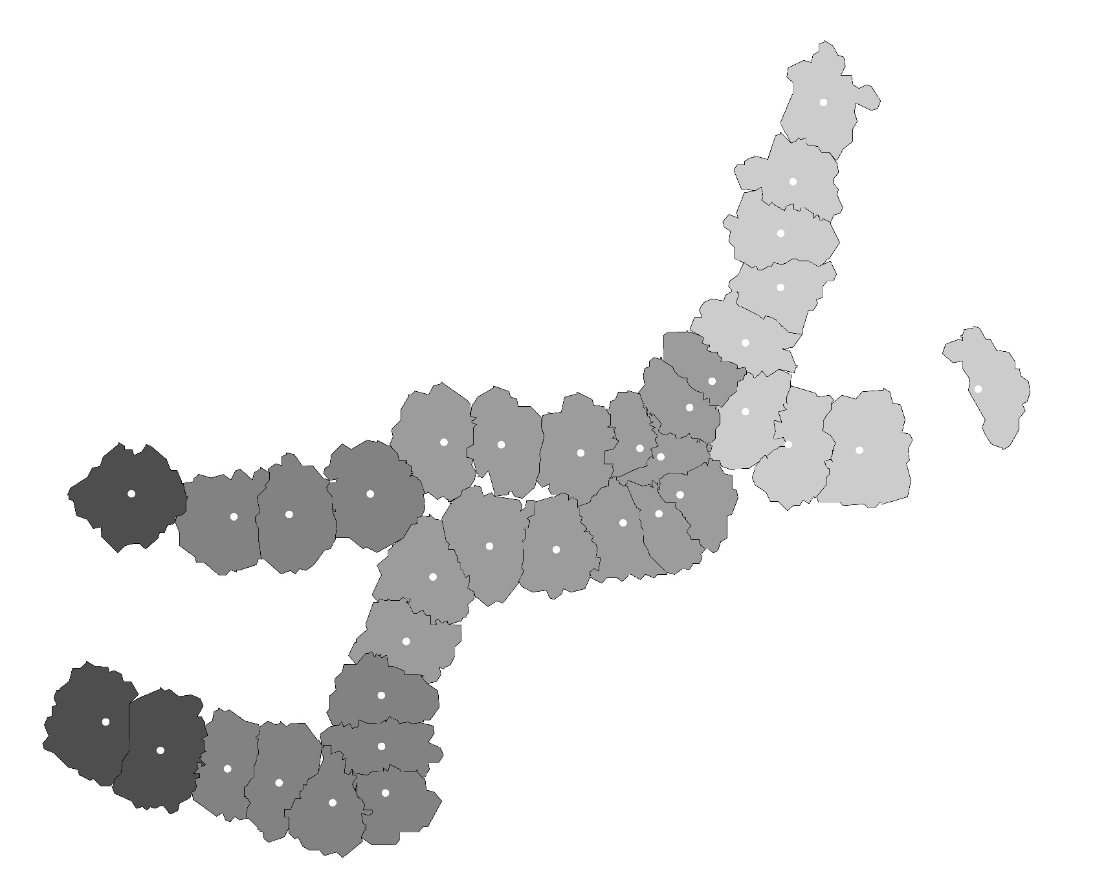
6. Residual Analysis
Distribution of Local R²
Local R²
0.960 - 0.965
0.965 – 0.970
0.970 – 0.975
0.975 – 0.980
Distribution of Residuals
Indicator | OLS | MGWR
Moran’s index | 0.08 | 0.03
Expected index | -0.03 | -0.03
Variance | 0.01 | 0.01
z-score | 1.09 | 0.61
p-value | 0.27 | 0.54
Moran’s index in MGWR is more closer to the expected index than that in OLS
Z-score in MGWR is less than that in OLS

Slide 15
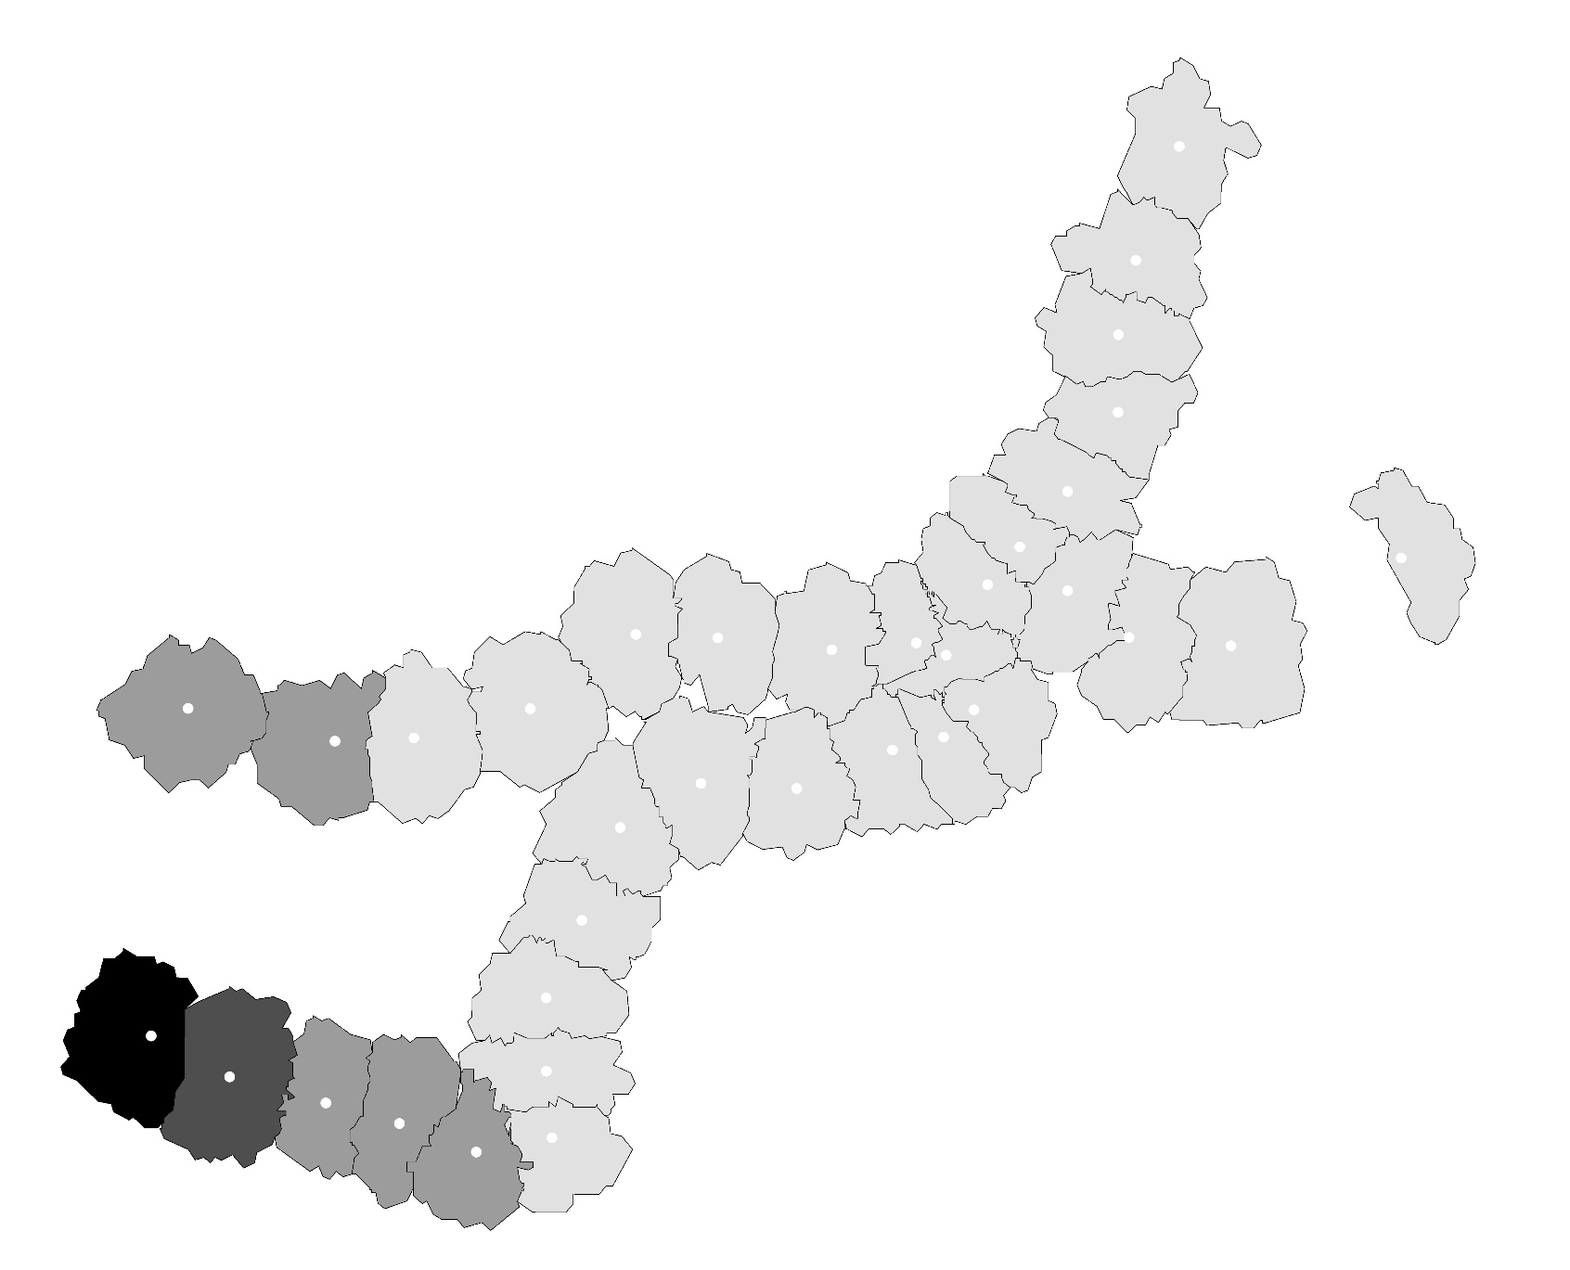
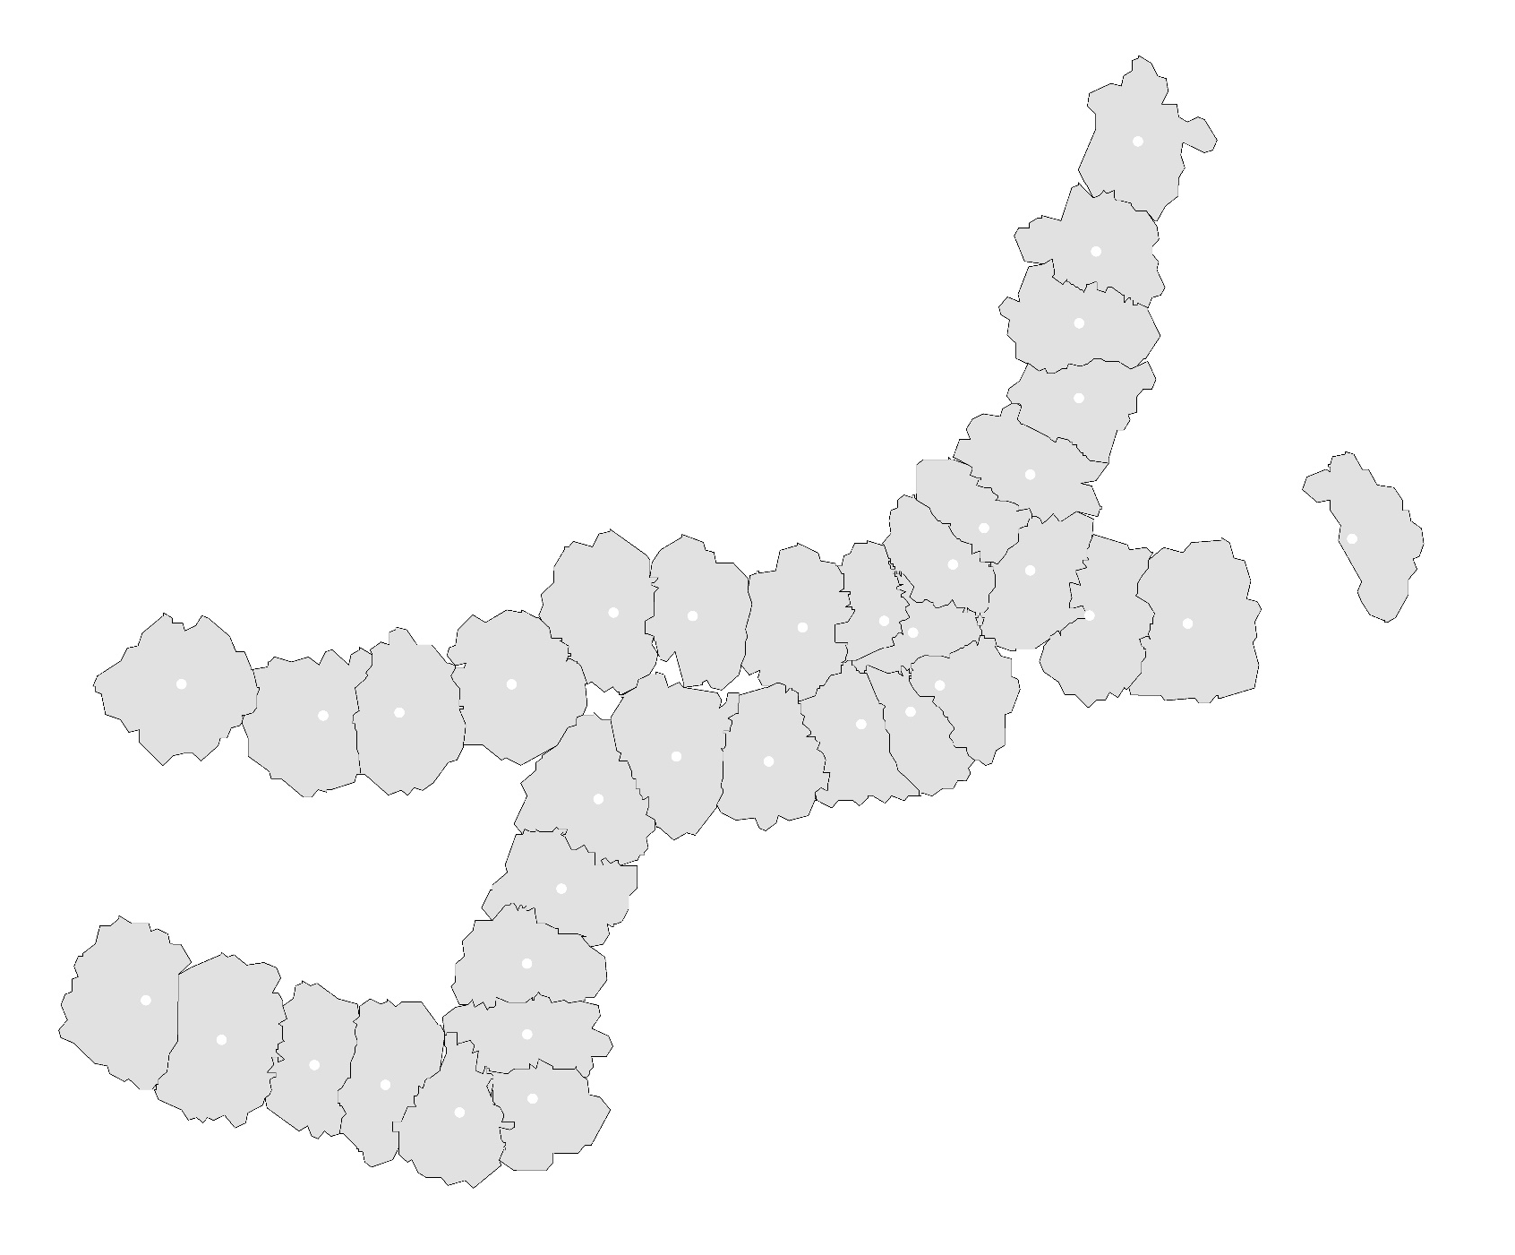
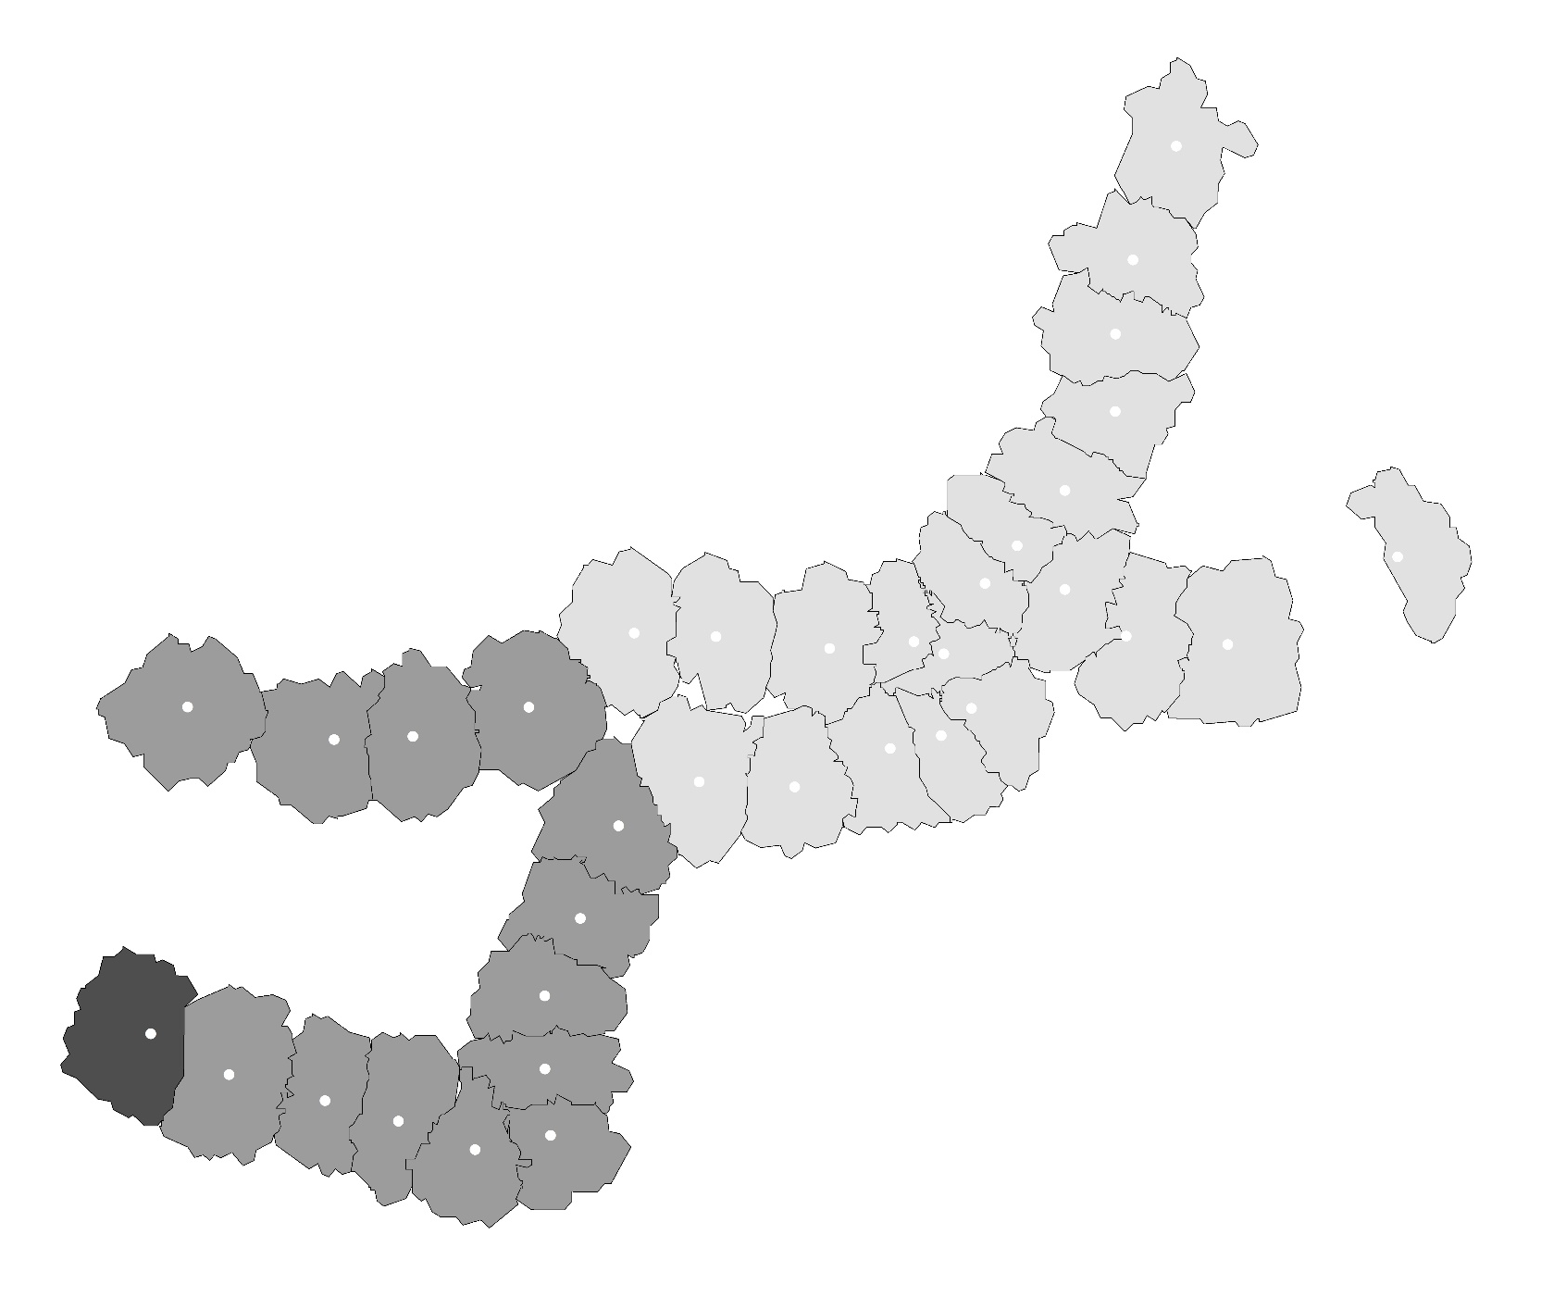
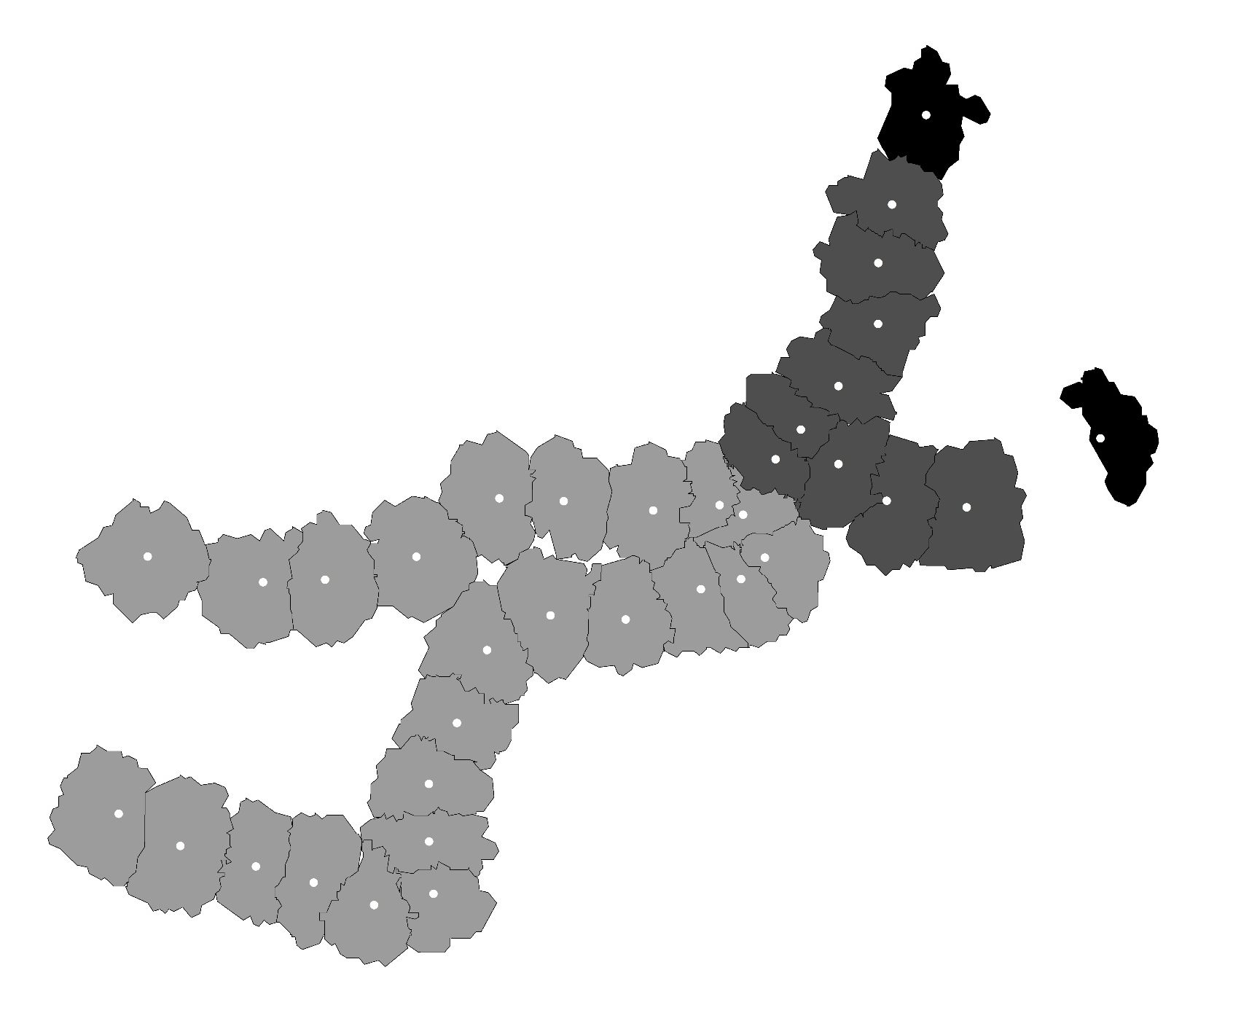
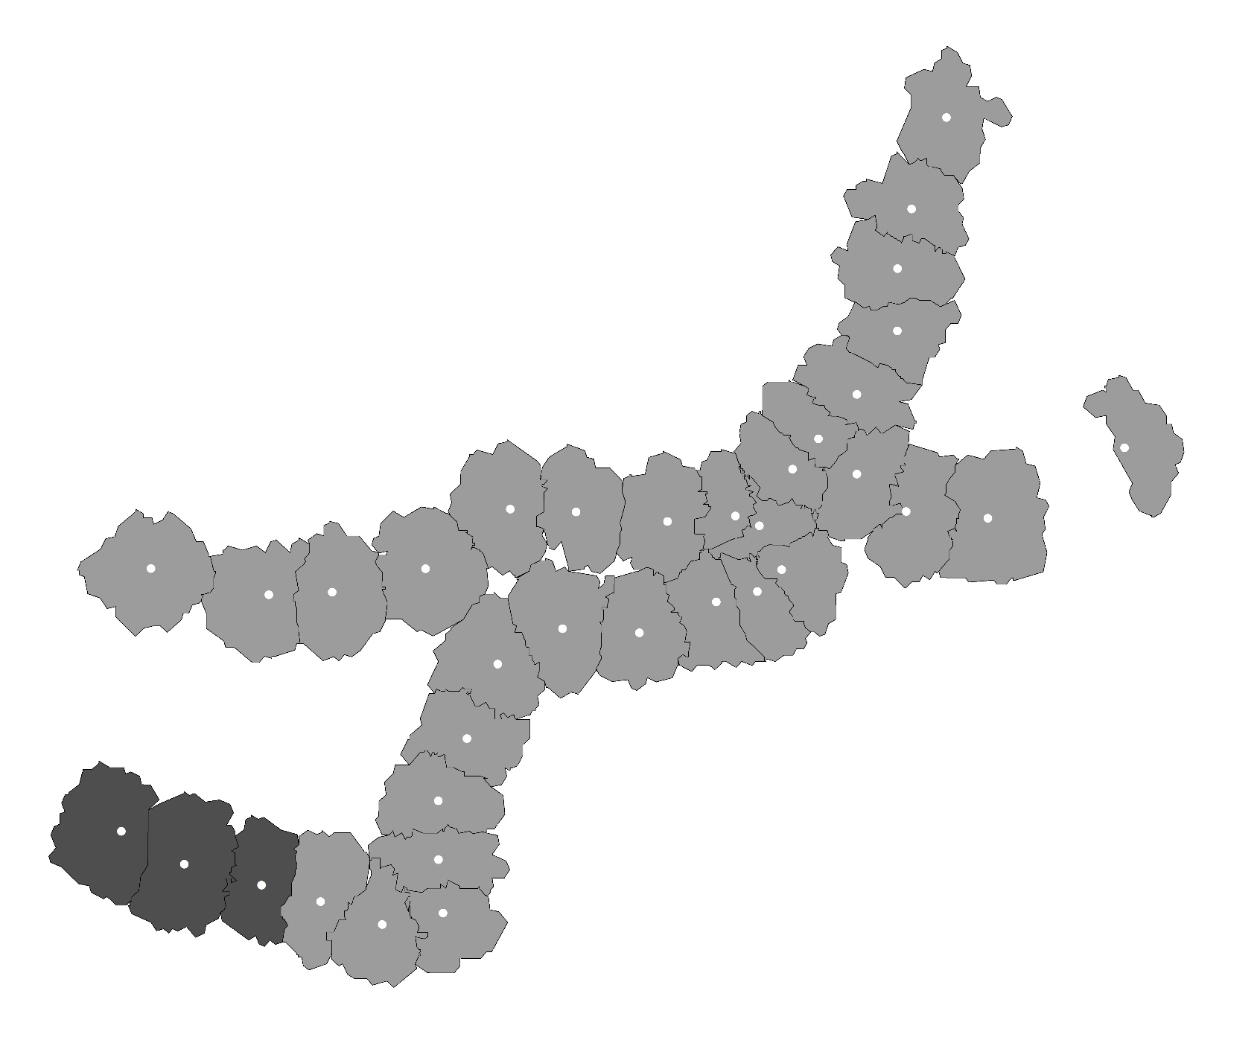
6. Residual Analysis
Significance Map
Transportation Facility Area
Bus Accessibility
Bus Capacity
Significance Map
Not Significance
P = 0.01
P = 0.05
P = 0.1
Population Job Balance
Tenant Proportion

Slide 16
6. Conclusion
Main Work
Reclassified and reorganized the indicator framework.
Proposed the approach of selecting variables from candidates using the tool of exploratory regression in ArcGIS.
Provided a method for judging whether a variable is global or local used in estimating the MGWR model.
Limitation
PCA
Station A
Station B
Connected
1
If the circumstance changed in one PCA
2
Ridership will changed in both stations

Slide 17
7. Further Research
Present Situation
Lack of the perspective of network
Lack of the consideration for the connectivity between stations
Lack of the exploration of TOD nature
Research Purpose
Explore how the factor of land-use influence the choice of destination station for passengers from the perspective of TOD
Research Content
Build the index framework
Convert the issue into a discrete choice model
Estimate this model using the case of Fukuoka

Slide 18
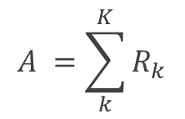
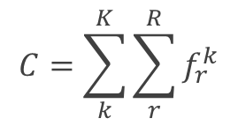
8. Index Framework
Land-use
Residence
Commerce
Business
Land-use Aggregation
Education
Impedance
Operating distance between stations
Bus capacity
Bus accessibility
$$C=\sum_{k}^{K}{\sum_{r}^{R}{f_{r}^{k}}}$$
$$A =\sum_{k}^{K}{R_{k}}$$

Slide 19
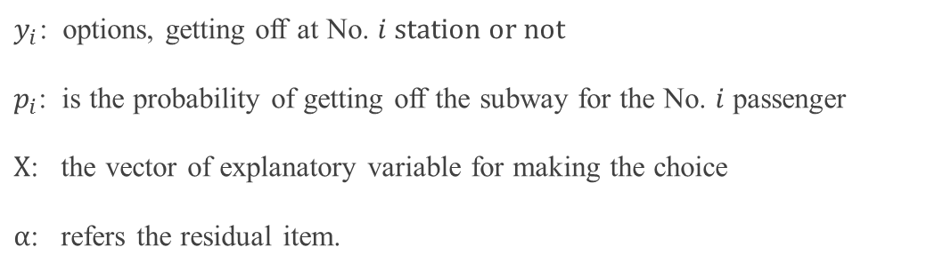
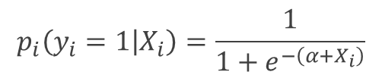
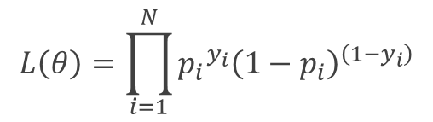
9. Discrete Choice Model
Logistic Regression Model
$$p_{i}\left(y_{i}=1 | X_{i}\right)=\frac{1}{1+e^{−\left(α+X_{i}\right)}}$$
Maximum Likelihood Estimation (MLE)
$$L\left(θ\right)=\prod_{i=1}^{N}{{{p_{i}}^{y_{i}}\left(1−p_{i}\right)}^{\left(1−y_{i}\right)}}$$
$y_{i}$: options, getting off at No. $i$ station or not
$p_{i}$: is the probability of getting off the subway for the No. $i$ passenger
$X$: the vector of explanatory variable for making the choice
$α$: refers the residual item.

Slide 20
10. Model Estimation
Selection of Object Station
Categorize all the Stations
Type | Population density | Commerce proportion | Office proportion | Residence proportion | Education proportion | Land-use aggregation | Bus capacity | Bus-accessibility
M-density Residence | 98 | 4% | 3% | 83% | 4% | 0.34 | 18 | 28
H-density Residence | 173 | 5% | 7% | 76% | 6% | 0.26 | 51 | 80
Education | 83 | 5% | 6% | 51% | 22% | 0.30 | 45 | 52
Office | 135 | 8% | 31% | 49% | 3% | 0.18 | 83 | 131
Commerce | 69 | 34% | 32% | 24% | 1% | 0.47 | 132 | 213
Airport | 36 | 1% | 3% | 45% | 2% | 0.23 | 32 | 56
Categorize all the Stations
Choose one station as object station from each category
M-density Residence | H-density Residence | Education | Office | Commerce | Airport
賀茂 | 藤崎 | 箱崎九大前 | 呉服町 | 天神 | 福岡空港

Slide 21
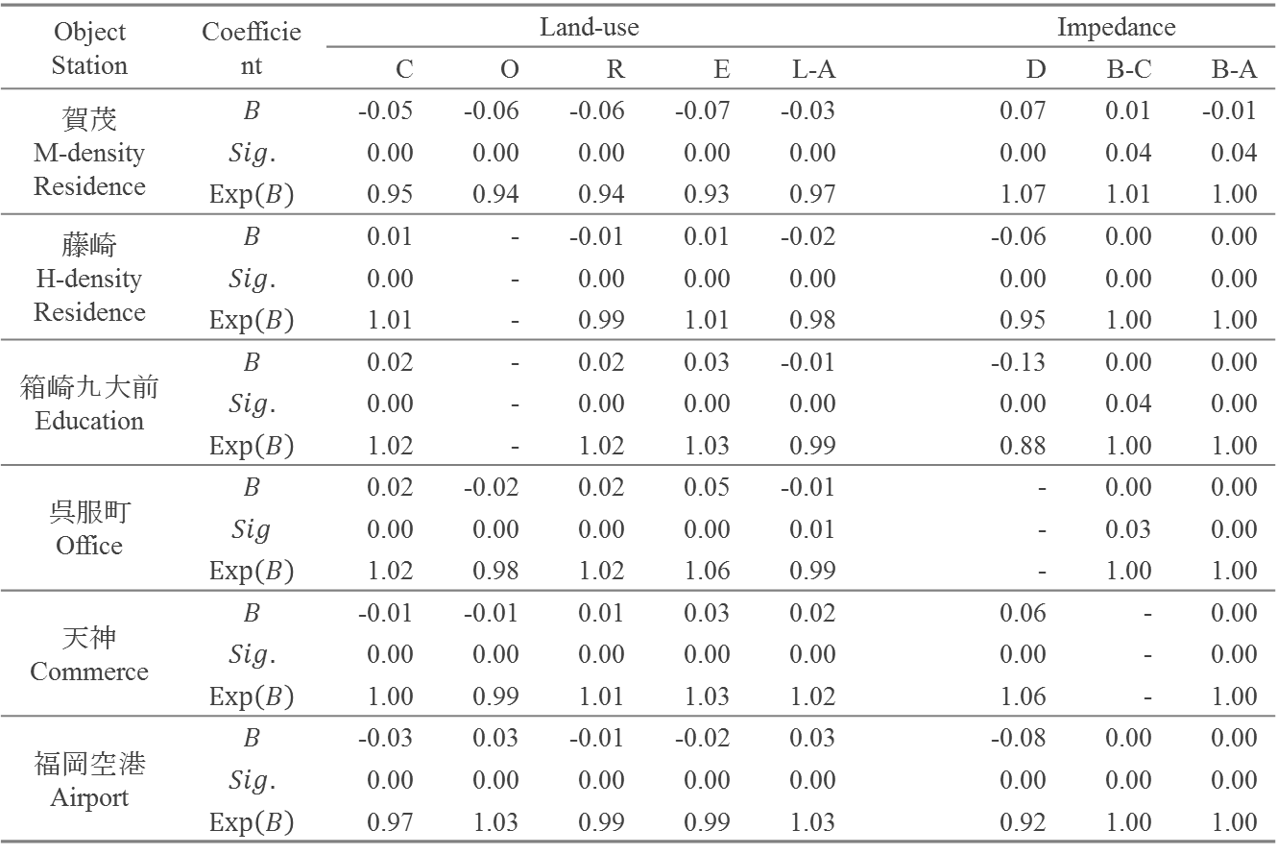
10. Model Estimation
Result for Logistic Regression
Object Station | Coefficient | Land-use |  |  |  |  |  | Impedance
 |  | C | O | R | E | L-A |  | D | B-C | B-A
賀茂 M-density Residence | $$B$$ | -0.05 | -0.06 | -0.06 | -0.07 | -0.03 |  | 0.07 | 0.01 | -0.01
 | $$Sig.$$ | 0.00 | 0.00 | 0.00 | 0.00 | 0.00 |  | 0.00 | 0.04 | 0.04
 | $$Exp\left(B\right)$$ | 0.95 | 0.94 | 0.94 | 0.93 | 0.97 |  | 1.07 | 1.01 | 1.00
藤崎 H-density Residence | $$B$$ | 0.01 | - | -0.01 | 0.01 | -0.02 |  | -0.06 | 0.00 | 0.00
 | $$Sig.$$ | 0.00 | - | 0.00 | 0.00 | 0.00 |  | 0.00 | 0.00 | 0.00
 | $$Exp\left(B\right)$$ | 1.01 | - | 0.99 | 1.01 | 0.98 |  | 0.95 | 1.00 | 1.00
箱崎九大前 Education | $$B$$ | 0.02 | - | 0.02 | 0.03 | -0.01 |  | -0.13 | 0.00 | 0.00
 | $$Sig.$$ | 0.00 | - | 0.00 | 0.00 | 0.00 |  | 0.00 | 0.04 | 0.00
 | $$Exp\left(B\right)$$ | 1.02 | - | 1.02 | 1.03 | 0.99 |  | 0.88 | 1.00 | 1.00
呉服町 Office | $$B$$ | 0.02 | -0.02 | 0.02 | 0.05 | -0.01 |  | - | 0.00 | 0.00
 | $$Sig$$ | 0.00 | 0.00 | 0.00 | 0.00 | 0.01 |  | - | 0.03 | 0.00
 | $$Exp\left(B\right)$$ | 1.02 | 0.98 | 1.02 | 1.06 | 0.99 |  | - | 1.00 | 1.00
天神 Commerce | $$B$$ | -0.01 | -0.01 | 0.01 | 0.03 | 0.02 |  | 0.06 | - | 0.00
 | $$Sig.$$ | 0.00 | 0.00 | 0.00 | 0.00 | 0.00 |  | 0.00 | - | 0.00
 | $$Exp\left(B\right)$$ | 1.00 | 0.99 | 1.01 | 1.03 | 1.02 |  | 1.06 | - | 1.00
福岡空港 Airport | $$B$$ | -0.03 | 0.03 | -0.01 | -0.02 | 0.03 |  | -0.08 | 0.00 | 0.00
 | $$Sig.$$ | 0.00 | 0.00 | 0.00 | 0.00 | 0.00 |  | 0.00 | 0.00 | 0.00
 | $$Exp\left(B\right)$$ | 0.97 | 1.03 | 0.99 | 0.99 | 1.03 |  | 0.92 | 1.00 | 1.00
The dependent variable is the choice of getting off at the object station or not

Slide 22
11. Conclusion
Summary
This study investigated the effect of land-use and impedance between stations on the subway ridership between stations from the perspective of the connectivity between stations.
The effect of factors on the choice of destination station was estimated using the logistic regression model. The result showed that the influence of land-use on the ridership between stations was effective.
Limitation
The share of different transportation modes is not considered in this study
The variables of bus service describe the features of one single station, but not the features between two stations

Slide 23
End
Thanks

Slide 24
An Analysis on the Interaction of Ridership and Land-use:
the Perspective from Connectivity between Subway Stations
Qi CHEN, Shichen ZHAO and Go HIGUCHI
Graduate School of Human-Environment Studies, Kyushu University, Japan
2017.07.14
Notes:
Hello, my name is CHEN Qi, I’m doctor two-year student at the Kyushu University in Japan. Now I’m going to talk about my research. The title is An Analysis on the Interaction of Ridership and Land-use: the Perspective from Connectivity between Subway Stations.

Slide 25
Background
Development of urban rail transit
The urban rail transit has become one of the most important travel modes in modern cities.
Public transit goes first
The policy of giving priority to the development of public transport has widely been adopted around the world.
Coordination between urban planning and urban rail transit
How to master the relationship between land-use and passenger volume has become an important issue.
1
Notes:
I will begin with a short introduction for the background. As we know, now the urban rail transit is one of the most important travel modes in our urban life. And, with the emphasis on sustainable development, the policy of giving priority to the development of public transport has been widely adopted. Thereby, for urban planners, to make a coordination between urban planning and urban rail transit, how to master the relationship between land-use and passenger volume has become an important issue.

Slide 26
Literature Review
 | Scale | Objective
Station-Level | single station | Passenger volume of station
Station-to-Station-Level | station network | OD passenger volume
Research Questions
To describe the connectivity between different stations using OD ridership.
To explain how the connectivity is determined by land-use factors.
Some References
[1] Taylor, B.D. et al., (2003). Analyzing the determinants of transit ridership using a two-stage least squares regression on a national sample of urbanized areas. University of California Transportation Center.
[2] Choi, J. et al., (2012). An analysis of Metro ridership at the station-to-station level in Seoul. Transportation, 39(3), 705–722.
[3] Gutiérrez, J., Cardozo, O.D. & García-Palomares, J.C., (2011). Transit ridership forecasting at station level: An approach based on distance-decay weighted regression. Journal of Transport Geography, 19(6), 1081–1092.
2
Notes:
With this background, I made a summary of previous studies. The studies in this research field can be divided into 2 levels. One is station-level, and the other one is station-to-station-level. At station-level, the research scale is single station, and the research objective is passenger volume of single station. It mainly focuses on the ridership prediction. In this kind of issue, the linear regression and some variance of regression are the most adopted methods. On the other hand, at station-to-station level, the research scale is the station network, and the research objective is OD passenger volume. The emphasis is not only the prediction of ridership, but also the connectivity between the station and station.

Slide 27
Research Flow
Dependent variable
Index framework
Independent variable
Conversion of realistic issue
Probability of getting off at a specific destination station
Discrete choice issue
Model estimation
Logistic regression
Result and Discussion
Notes:
This is the research flow of this study. First, I will construct the index framework, and then convert this realistic issue into a mathematical problem. Finally, estimate the logistic regression model, and give discussion for the result.

Slide 28
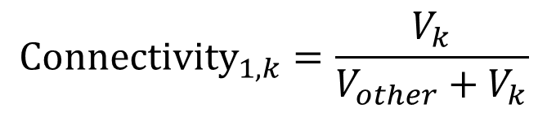


Index Framework
Description for Connectivity —— dependent variable
Other
Stations
2
3
Passenger Volume
4
5
$$V_{other}$$
Station
1
……
Station k
Passenger Volume
k
$$V_{k}$$
Boarding
Alighting
$${Connectivity}_{1,k}=\frac{V_{k}}{V_{other}+V_{k}}$$
5
Notes:
OK, let’s see the index framework. The dependent variable in this study is the connectivity between the station and station. This connectivity can be expressed by the passenger volume. As is shown, if we take an example of the connectivity between station 1 and station k, the passengers boarding from station 1 can make the choice for getting off at station k or at the other stations. We can note the passenger volume between station 1 and station k as Vk, and note the passenger volume from station 1 to the other stations as Vother. The connectivity can be defined as this formula.

Slide 29
Index Framework
Determinants for transit ridership —— independent variables
Land-use
Residence proportion
Office proportion
Commerce proportion
Education proportion
Land-use aggregation
Impedance
Bus capacity
Operation distance of subway
Bus accessibility
Notes:
This is the independent variables in this study. The factors are selected from two aspects, land-use and impedance. For land-use factors, we chose the proportion of different land-use types and the variable for describing the balance of land-use. For the impedance factors, we chose bus capacity, bus accessibility, and subway operation distance, these three variables.

Slide 30
Method
Realistic issues
Boarding
Alighting
Station 1
Other
Stations
Station 2
……
……
Station k
Impedance between boarding and alighting station
Independent variable
Affect
Dependent variable
Choice of whether to get off at station k
land-use feature of boarding station
Notes:
Before constructing the mathematical model, I am going to explain how to convert this realistic problem into a mathematical problem. If we examine the case of alighting station k, this probability of getting off at station k is affected by the land-use and impedance of boarding station. Here we can convert this problem into a discrete choice problem. And it can be expressed using logistic regression. In this logistic regression, if we take the alighting station k as an example, the dependent variable is the connectivity between all the boarding stations and alighting station k, it is the probability of getting off at station k. The independent variables are the land-use of departure stations and the impedance between boarding stations and the alighting station k.

Slide 31
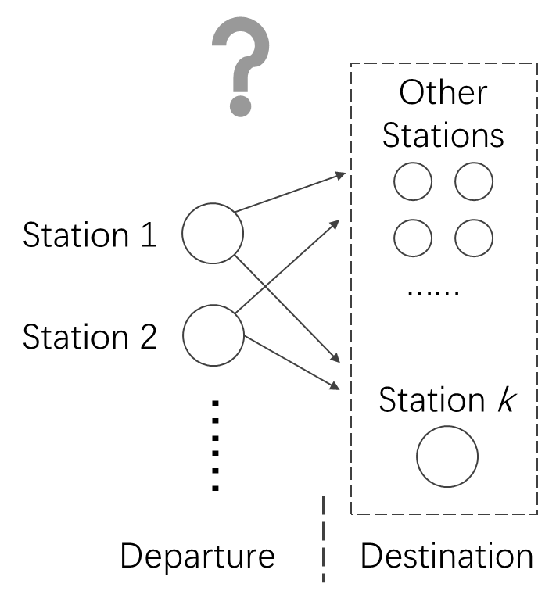
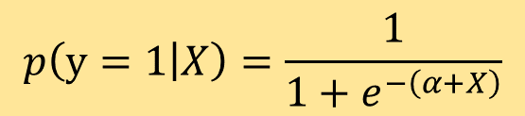

Method
Mathematical problems
Logistic regression model
$$p\left(y=1 | X\right)=\frac{1}{1+e^{−\left(α+X\right)}}$$
$p$: probability of getting off
$y$ : result of choice
$X$ : vector of explanatory variable
$α$ : residual item.
Discrete choice issue
Notes:
This discrete choice issue can be further converted into a logistic regression model. In model is as shown in the slide, where the Y means the choice of whether getting off at objective station, and X means the vector of explanatory variables.

Slide 32
Method
Select sample station
Station type | Station name | Population density | Commerce proportion | Office proportion | Residence proportion | Education proportion
Medium-density residence | Kamo | 98 Person/Ha | 4% | 3% | 83% | 4%
High-density residence | Fujisaki | 173 Person/Ha | 5% | 7% | 76% | 6%
Education | Hakozakikyudai | 83 Person/Ha | 5% | 6% | 51% | 22%
Office | Gofukumachi | 135 Person/Ha | 8% | 31% | 49% | 3%
Commerce | Tenjin | 69 Person/Ha | 34% | 32% | 24% | 1%
Airport | Fukuoka Airport | 36 Person/Ha | 1% | 3% | 45% | 2%
Note:
The highlighted cells refer to the representative values that having much higher percentage than other land-use types.
9
Notes:
In this problem, what we want to know is how the independent variables determine the choice of where to get off. To master the significant features of connectivity between station and station with different type of land-use, we are going to select some typical stations as research objective. Firstly, we classify all the stations in terms of the proportion of land-use types and population density. And then choose one station as the destination from each group to estimate. The six stations are Kamo station of medium-density residence, Fujisaki station of high-density residence, Hakozakikyudai station of education, Gofukumachi station of office, Tenjin station of commerce, and airport station.

Slide 33
Result and Discussion
Result of estimation
Destination Station |  | Variables in Departure Station
Type | Destination Station | Land-use |  |  |  |  |  | Impedance
 |  | C | O | R | E | L-A |  | D | B-C | B-A
Medium-density residence | Kamo | 0.95 | 0.94 | 0.94 | 0.93 | 0.97 |  | 1.07 | 1.01 | 1.00
High-density residence | Fujisaki | 1.01 |  | 0.99 | 1.01 | 0.98 |  | 0.95 | 1.00 | 1.00
Education | Hakozakikyudai | 1.02 |  | 1.02 | 1.03 | 0.99 |  | -0.13 | 0.00 | 0.00
Office | Gofukumachi | 1.02 | 0.98 | 1.02 | 1.06 | 0.99 |  |  | 1.00 | 1.00
Commerce | Tenjin | 1.00 | 0.99 | 1.01 | 1.03 | 1.02 |  | 1.06 |  | 1.00
Airport | Airport | 0.97 | 1.03 | 0.99 | 0.99 | 1.03 |  | 0.92 | 1.00 | 1.00
Note: full name of the abbreviation
C: Commerce, O: Office, R: Residence, E: Education, L-A: Land-use Aggregation, D: Distance, B-C: Bus Capacity, B-A: Bus Accessibility.
10
Notes:
This is the result of estimation. In this table, the coefficient larger than 1 means if this variable raised, the probability of choosing the corresponding station as destination will also raise. The coefficient means that 1 unit change in the variables will lead to an this value’s multiples of increases in the probability of getting off at the destination. The blank means this value does not pass the statistical significance test.

Slide 34
Result and Discussion
Discussion for results
Destination Station |  | Variables in Departure Station
Type | Destination Station | Land-use |  |  |  |  |  | Impedance
 |  | C | O | R | E | L-A |  | D | B-C | B-A
Medium-density residence | Kamo | 0.95 | 0.94 | 0.94 | 0.93 | 0.97 |  | 1.07 | 1.01 | 1.00
High-density residence | Fujisaki | 1.01 |  | 0.99 | 1.01 | 0.98 |  | 0.95 | 1.00 | 1.00
Education | Hakozakikyudai | 1.02 |  | 1.02 | 1.03 | 0.99 |  | -0.13 | 0.00 | 0.00
Office | Gofukumachi | 1.02 | 0.98 | 1.02 | 1.06 | 0.99 |  |  | 1.00 | 1.00
Commerce | Tenjin | 1.00 | 0.99 | 1.01 | 1.03 | 1.02 |  | 1.06 |  | 1.00
Airport | Airport | 0.97 | 1.03 | 0.99 | 0.99 | 1.03 |  | 0.92 | 1.00 | 1.00
Result: Medium-density residence have weak connectivity with all other types.
Discussion: The private traffic ratio is higher.
10
Notes:
Here I’m going to give some of the discussions for the result. Let’s see the coefficients marked with red frame. All the value is less than 1, it means the medium-density residence have weak connectivity with all other types of land-use. One possible reason may be that the private traffic ratio is higher in the medium-density, so the passenger volume is not sensitive to the change in land-use.

Slide 35
Result and Discussion
Discussion for results
Destination Station |  | Variables in Departure Station
Type | Destination Station | Land-use |  |  |  |  |  | Impedance
 |  | C | O | R | E | L-A |  | D | B-C | B-A
Medium-density residence | Kamo | 0.95 | 0.94 | 0.94 | 0.93 | 0.97 |  | 1.07 | 1.01 | 1.00
High-density residence | Fujisaki | 1.01 |  | 0.99 | 1.01 | 0.98 |  | 0.95 | 1.00 | 1.00
Education | Hakozakikyudai | 1.02 |  | 1.02 | 1.03 | 0.99 |  | -0.13 | 0.00 | 0.00
Office | Gofukumachi | 1.02 | 0.98 | 1.02 | 1.06 | 0.99 |  |  | 1.00 | 1.00
Commerce | Tenjin | 1.00 | 0.99 | 1.01 | 1.03 | 1.02 |  | 1.06 |  | 1.00
Airport | Airport | 0.97 | 1.03 | 0.99 | 0.99 | 1.03 |  | 0.92 | 1.00 | 1.00
Result: Education type have strong connectivity with most of other types.
Discussion: Students are more inclined to use subway.
10
Notes:
Next, let’s see the coefficient under the factor of education. Most of the values are larger than 1, it means education type have strong connectivity with most of other types. This may be because students are more inclined to use subway than the other group of people, public transport is the main transportation mode for students.

Slide 36
Result and Discussion
Discussion for results
Destination Station |  | Variables in Departure Station
Type | Destination Station | Land-use |  |  |  |  |  | Impedance
 |  | C | O | R | E | L-A |  | D | B-C | B-A
Medium-density residence | Kamo | 0.95 | 0.94 | 0.94 | 0.93 | 0.97 |  | 1.07 | 1.01 | 1.00
High-density residence | Fujisaki | 1.01 |  | 0.99 | 1.01 | 0.98 |  | 0.95 | 1.00 | 1.00
Education | Hakozakikyudai | 1.02 |  | 1.02 | 1.03 | 0.99 |  | -0.13 | 0.00 | 0.00
Office | Gofukumachi | 1.02 | 0.98 | 1.02 | 1.06 | 0.99 |  |  | 1.00 | 1.00
Commerce | Tenjin | 1.00 | 0.99 | 1.01 | 1.03 | 1.02 |  | 1.06 |  | 1.00
Airport | Airport | 0.97 | 1.03 | 0.99 | 0.99 | 1.03 |  | 0.92 | 1.00 | 1.00
Result: Similar types have weak connectivity
Discussion: Traffic demand is generated by different trip purpose
10

Slide 37
Limitation
Other traffic modes
The share of other transportation modes is not considered in this study.
Impedance factors
The two variables about bus system did not reflect the connectivity between two stations very well.
13
Notes:
Here are some shortcomings and limitations that I summarized for this study, but not limited to these.

Slide 38
Acknowledgements
Prof. Zhao Shichen
For acting as my advisor for all my research
Mr. Higuchi Go
For assisting me for the data collection and processing in this research
16

Slide 39
Thank You for Listening
Notes:
That’s all, thank you for listening.

Slide 40
References
Cervero, R., (2004). Transit-Oriented Development in the United States: Experiences, Challenges, and Prospects, Transportation Research Board.
Gutiérrez, J., Cardozo, O.D. & García-Palomares, J.C., (2011). Transit ridership forecasting at station level: An approach based on distance-decay weighted regression. Journal of Transport Geography, 19(6), 1081–1092.
Choi, J. et al., (2012). An analysis of Metro ridership at the station-to-station level in Seoul. Transportation, 39(3), 705–722.
Chakraborty, A. & Mishra, S., (2013). Land use and transit ridership connections: Implications for state-level planning agencies. Land Use Policy, 30(1), 458–469.
15

Slide 41
Remarks
Research Area

Slide 42
Remarks
Proportion of land-use in different PCA
Range of PCA | Residence | Office | Commerce | Education | Total
600 | 51.8% | 19.3% | 13.8% | 5.5% | 90.5%
800 | 55.3% | 17.5% | 12.0% | 6.2% | 90.9%
1000 | 57.6% | 16.5% | 10.8% | 6.0% | 90.9%
1200 | 59.2% | 15.5% | 10.2% | 5.9% | 90.8%
Ave | 62.8% | 10.1% | 7.5% | 5.3% | 85.7%

Slide 43
Remarks
Main accessing mode for subway stations in Fukuoka
 | Walking |  | Bicycle
 | Proportion | Ave time (min) | Proportion | Ave time (min)
Average | 78% | 7.2 | 9% | 9.0
median | 85% | 7.0 | 8% | 9.5
Min | 22% | 4.8 | 0% | 0.0
Max | 100% | 9.2 | 33% | 20.0

Slide 44
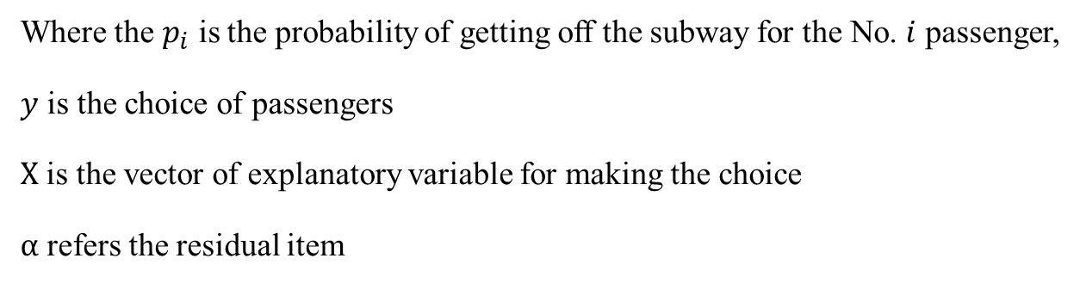
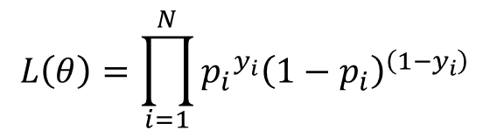
Remarks
Method of estimating the logistic model
Least squares method
$$L\left(θ\right)=\prod_{i=1}^{N}{{{p_{i}}^{y_{i}}\left(1−p_{i}\right)}^{\left(1−y_{i}\right)}}$$
Where the $p_{i}$ is the probability of getting off the subway for the No. $i$ passenger,
$y$ is the choice of passengers
$X$ is the vector of explanatory variable for making the choice
$α$ refers the residual item

Slide 45
Remarks
Shortcomings of previous studies
Station level
The ridership is thought to be only affected by the circumstance surrounding the station, the connectivity between stations cannot be reflected.
Station-to-station
Because of the aggregate processing for the data from both departures and destinations, the connectivity between station areas is still not reflected.
3
Notes:
On the basis of previous studies, here I’m trying to find some problems and to position my study in this research field.
For station-level research, obviously, the ridership is thought to be only affected by the circumstance surrounding the station, the connectivity between stations and stations cannot be reflected. There is the same problem in the existing study of station-to-station level, although the OD passenger volume is examined, because of the aggregate processing of data, the connectivity is not well interpreted.

Slide 46
Research Question
To describe the connectivity between different stations using OD ridership.
To build the relationship between connectivity and influencing factors, and then convert this realistic problem into a mathematical problem.
To explain how land-use and impedance factors affect the connectivity between different stations.
4
Notes:
Therefore, in this study, I am going to mainly deal with these three questions. 1. 2. 3.

Slide 47
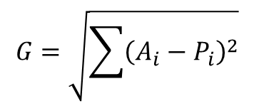
Index Framework
Determinants for transit ridership —— independent variables
$$G=\sqrt{\sum{{\left(A_{i}−P_{i}\right)}^{2}}}$$
Land-use
Residence proportion
Office proportion
Commerce proportion
Education proportion
Land-use aggregation
The lower value means a higher diversity in land-use function. This value ranges from 0-1.
6
Notes:
The factors that are expected to affect the connectivity between stations and stations are classified into land-use and impedance. For the land-use factors, we selected the floor area proportion of 4 main land-use functions, they are residence, office, commerce, and education. And to describe the balance of each kind of land-use function, the index of land-use aggregation is also introduced into this framework. The lower value of land-use aggregation means a higher diversity in land-use function. This value ranged from 0-1.

Slide 48
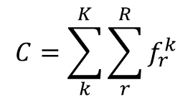
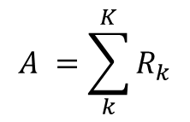
Index Framework
Determinants for transit ridership
Impedance
$$C=\sum_{k}^{K}{\sum_{r}^{R}{f_{r}^{k}}}$$
Operation distance of subway
Bus capacity
Means the transport capacity of the bus within the walking distance of the station, this index is considered as a negative factor for the ridership.
Bus traffic volume
Catchment area
Station
Large
Small
Bus accessibility
$$A =\sum_{k}^{K}{R_{k}}$$
Bus routes
More
Less
7
Represents the convenience for accessing the station, this index is speculated as a positive factor for the ridership.
Notes:
Impedance is also a determinant for transit ridership. The operation distance of subway between station and station can represent the spatial connectivity, this operation distance is thought to be one of the factors to affect the choice of traffic modes. And the impedance of bus is also considered in this study. A convenient bus system can share part of the subway passengers. The bus capacity means the transport capacity of the bus within the PCA of the station, this index is considered as a negative factor for the ridership. The bus accessibility represents the convenience for accessing the station, this index is speculated as a positive factor for the ridership.

Slide 49
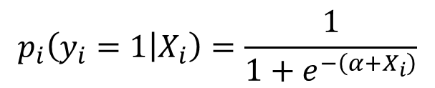

Method
Realistic problems
Mathematical problems
Logistic regression model
Other
Stations
$$p_{i}\left(y_{i}=1 | X_{i}\right)=\frac{1}{1+e^{−\left(α+X_{i}\right)}}$$
Station 1
$i$ : Serial number of passenger
$p_{i}$: probability of getting off
$y$ : result of choice
$X$ : vector of explanatory variable
$α$ : residual item.
……
Station 2
Station k
……
Departure
Destination
8
Notes:
Because the connectivity between stations and stations can be viewed as a procedure of choosing where to get off.
Before constructing the mathematical model, I’m going to explain how the realistic problem is converted into a mathematical problem. In reality, as I have just stated, the connectivity between station A and Z can be viewed as the probability of getting off at station Z. If we examine the case of destination station Z, this probability of getting off at station Z is affected by the land-use and impedance of departure station. Here we can convert this problem into a discrete choice problem. And it can be expressed using logistic regression. In this logistic regression, if we take the destination station Z as an example, the dependent variable is the connectivity between all the departure stations and destination station Z, it is the probability of getting off at the destination station Z. The independent variables are the land-use of departure stations and the impedance between departure stations and the destination station Z.

Slide 50
Result
How to read
Destination Station |  | Variables in Departure Station
Type | Destination Station | Land-use |  |  |  |  |  | Impedance
 |  | C | O | R | E | L-A |  | D | B-C | B-A
Medium-density residence | Kamo | 0.95 | 0.94 | 0.94 | 0.93 | 0.97 |  | 1.07 | 1.01 | 1.00
High-density residence | Fujisaki | 1.01 |  | 0.99 | 1.01 | 0.98 |  | 0.95 | 1.00 | 1.00
Education | Hakozakikyudai | 1.02 |  | 1.02 | 1.03 | 0.99 |  | -0.13 | 0.00 | 0.00
Office | Gofukumachi | 1.02 | 0.98 | 1.02 | 1.06 | 0.99 |  |  | 1.00 | 1.00
Commerce | Tenjin | 1.00 | 0.99 | 1.01 | 1.03 | 1.02 |  | 1.06 |  | 1.00
Airport | Airport | 0.97 | 1.03 | 0.99 | 0.99 | 1.03 |  | 0.92 | 1.00 | 1.00
For the variables of land-use, the efficient means that the 1 percent (0.01 unit) change in the variables will lead to a rate of increases in the probability of getting off at this destination station.
For the variables of impedance, it means the 1 unit change in the variables will lead to a rate of increases in the probability of choosing the station as a destination.
11
Notes:
Here I am going to give an explanation in more detail. If taking the Fujisaki station as an example, from the factor of land-use, we can see the increase of commerce and education proportion around the departure stations can lead to a increase in the probability of choosing the Fujisaki station as the destination. While the increase of residence proportion around the departure stations will decrease the probability of getting off at Fujisaki station. And look at the factor of impedance, we can know the closer station has stronger connectivity with Fujisaki station.

Slide 51
Conclusion
The factors around the departure stations have significant impact on the choice of destination station.
High-density residence area have strong connectivity with employment-intensive area.
If the land-use features of both departure and destination station are similar, the connectivity between the two stations is weak.
Education area have strong connectivity with the areas with all other types of land-use feature
Impedance showed no certain regularity in different type of stations.
12

Slide 52
Future Research
To focus on the share ratio in different transportation modes to make a deeper exploration of subway ridership.
To rebuilt the factor of impedance to help to de-scribe the connectivity between stations more accurately.
14

Slide 53
Research Question
Weakness in previous studies
Research question in this study
To describe the connectivity between different stations using OD ridership.
To explain how the connectivity is determined by land-use factors..
Lack of consideration on connectivity
Notes:
Based on the summary of previous studies, both of station-level and station-to-station-level lack the consideration of connectivity between the station and station. For this problem, I will try to deal with the two questions in this study. 1.2.

Slide 54
Result and Discussion
Discussion for results
Destination Station |  | Variables in Departure Station
Type | Destination Station | Land-use |  |  |  |  |  | Impedance
 |  | C | O | R | E | L-A |  | D | B-C | B-A
Medium-density residence | Kamo | 0.95 | 0.94 | 0.94 | 0.93 | 0.97 |  | 1.07 | 1.01 | 1.00
High-density residence | Fujisaki | 1.01 |  | 0.99 | 1.01 | 0.98 |  | 0.95 | 1.00 | 1.00
Education | Hakozakikyudai | 1.02 |  | 1.02 | 1.03 | 0.99 |  | -0.13 | 0.00 | 0.00
Office | Gofukumachi | 1.02 | 0.98 | 1.02 | 1.06 | 0.99 |  |  | 1.00 | 1.00
Commerce | Tenjin | 1.00 | 0.99 | 1.01 | 1.03 | 1.02 |  | 1.06 |  | 1.00
Airport | Airport | 0.97 | 1.03 | 0.99 | 0.99 | 1.03 |  | 0.92 | 1.00 | 1.00
Result: Similar types have weak connectivity
Discussion: Traffic demand is generated by different trip purpose
10
Notes:
Another interesting finding is that the connectivity between similar types of land-use is not strong. This is also consistent with expectation. Because as we know traffic demand is generated by different trip purpose, people will have less motivation to go to a further place using subway if they can achieve their trip purpose within walking distance.

Slide 55
Explaining Walking Duration to Transit Stations by Socio-Demographic Characteristics
Reporter: Qi CHEN
Kyushu University, Japan
2018.01.06

Slide 56
1. Introduction
Research position
Superior Topic
Exploring the use tendencies of urban rail transit
Built-environment
Facilities
Behaviors
Driving Forces
Personal Socio-Demographic Characteristics
(abbreviated as PSDC)
Research Point
(This Study)
Relationship
Walking duration to transit stations

Slide 57

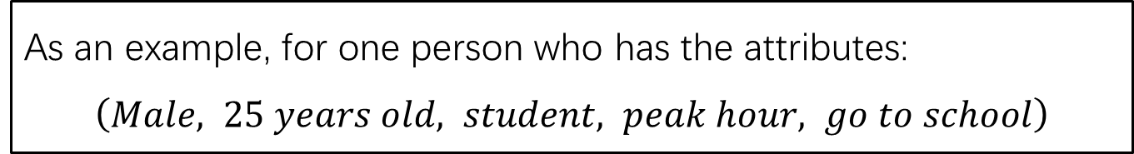
1. Introduction
Problem description
As an example, for one person who has the attributes:
$\left(Male, 25 years old, student, peak hour, go to school\right)$
Realistic issue
I can accept a walking duration less than 8 minutes
OK
8 min
4 min
0 min
Reflected in questionnaire
This time I walked 6 minutes to the station
6 min
0 min

Slide 58

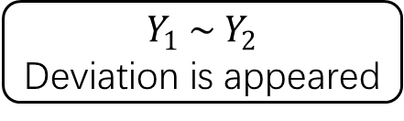
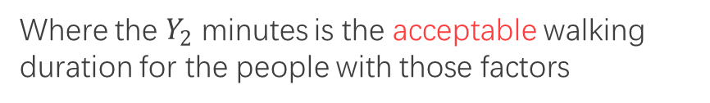
1. Introduction
In a general way
The general expression can be:
$$Walking duration=F\left({factor}_{1}, {factor}_{2},{factor}_{3}, ……\right)$$
Walking duration obtained from questionnaire
$$Y_{1} min=F\left({factor}_{1}, {factor}_{2},{factor}_{3}, ……\right)$$
Where the $Y_{1}$ minutes is the reflection of the duration between departures and stations
$$Y_{1} \sim Y_{2}$$
Deviation is appeared
Actually acceptable walking duration
$$Y_{2} min=F\left({factor}_{1}, {factor}_{2},{factor}_{3}, ……\right)$$
Where the $Y_{2}$ minutes is the acceptable walking duration for the people with those factors

Slide 59


1. Introduction
The work of this study
Research purpose
Explorer the how the PSDC can affect the acceptable walking duration to transit stations.
Entry point
Try to explain the acceptable walking duration using probability.
Research object
Examine the probability at the given threshold of walking duration
Continuous value of Walking duration
Threshold of walking duration
$$t_{1}\sim t_{2}$$
$$t_{1}, t_{2}, t_{3}……$$

Slide 60
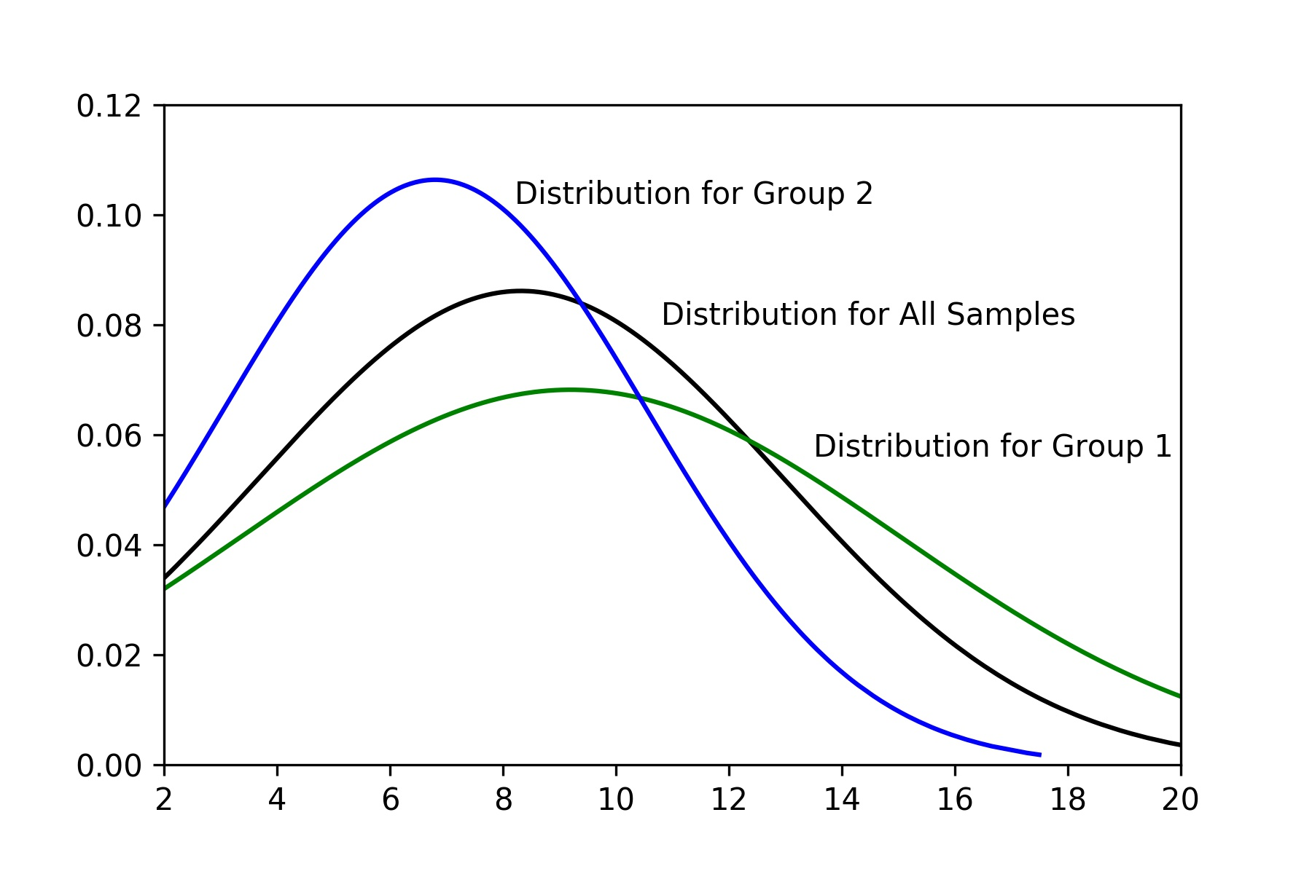
2. Methods
Important assumption
Group 1
Group 2
Probability
All Samples
6 min
If considering the threshold of 6 minutes
minute
Assuming the walking duration distribution of the passengers with the same attributions subject to the normal distribution.
If the survey result obtained from the questionnaire showed one group of passengers with a particular PSDC tend to walk longer, it means this group of passengers can accept a longer walking duration.
In this graph it can be considered that Group 1 can accept a longer walking duration than Group 2

Slide 61
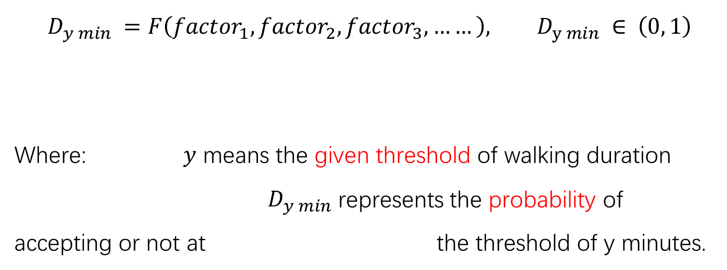
2. Methods
Model construction
Abstract form of the model
PSCD
$$D_{y min} =F\left({factor}_{1}, {factor}_{2},{factor}_{3}, ……\right), D_{y min} ∈ \left(0, 1\right)$$
Where: $y$ means the given threshold of walking duration
$D_{y min}$ represents the probability of accepting or not at the threshold of y minutes.

Slide 62
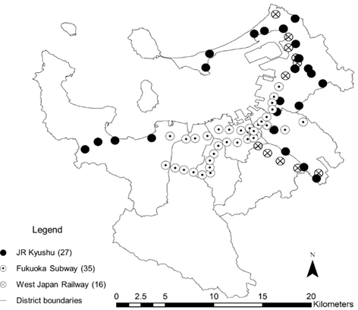
2. Data Description
Available data
Distribution of the transit stations
Available data in this study

Slide 63
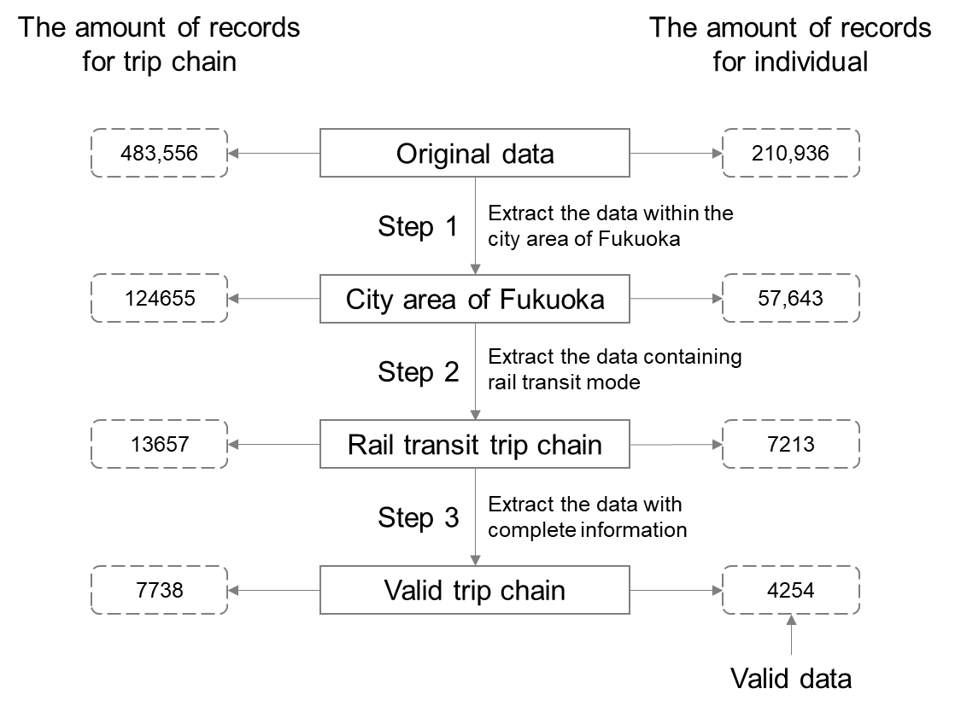
2. Data Description
Data disposal
Source: Person Trip Survey

Slide 64
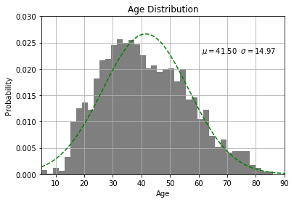
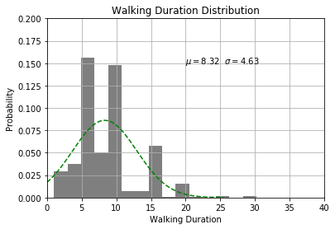
2. Data Description
Distribution verification
There are peak values at 5, 10, 15 min
The age distribution of passengers
Distribution of walking duration
People are inclined to reply a looser answer when they are being asked some questions about details.
Subject to normal distribution, the samples can be viewed valid.

Slide 65
3. Selection for Valid Features
Selection of thresholds
According to the existing studies, the acceptable walking duration mainly range from 5 – 13 minutes.
In this study, the average walking duration is about 8 minutes.
The thresholds selected in this study is 5, 8, 13 minutes.
Analysis of variance
L : tend to spend Less than the threshold
M: tend to spend more than the threshold
Valid Features at each threshold

Slide 66
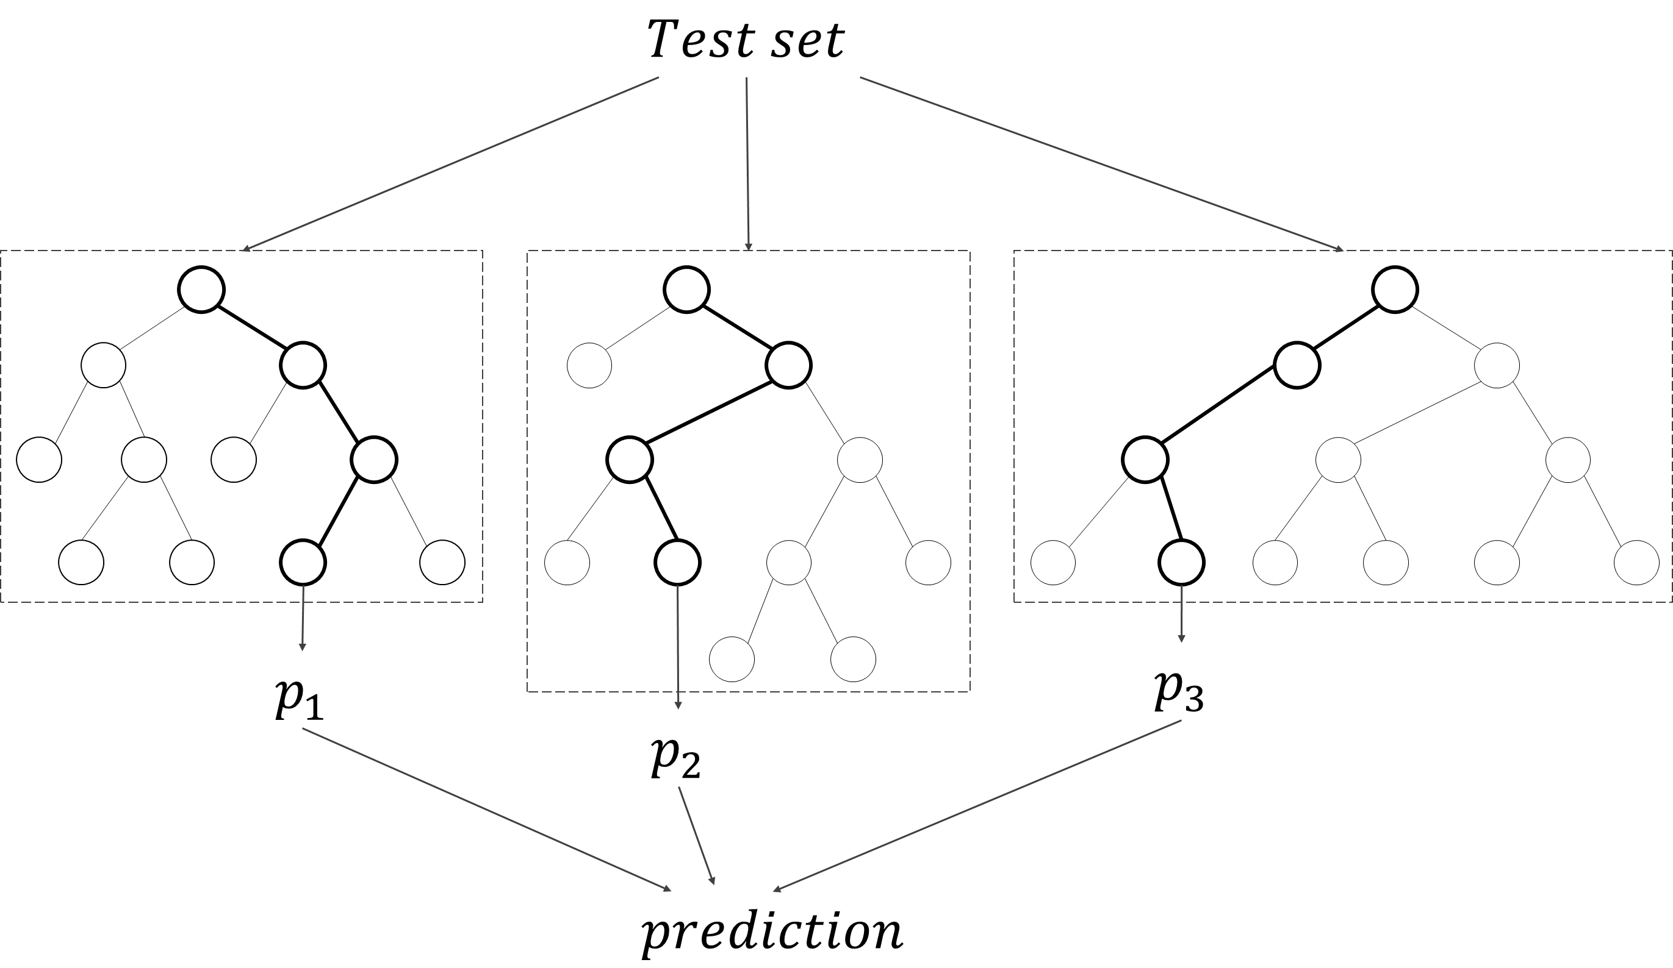
4. Estimation of Features
The rationality of model selection
Decision tree
Bayesian model
Good generalization for different forms of data
Binary choice issue
Support vector machine
Artificial neural networks
… …
Decision tree and forest random models
Forest random model is constructed by random selection of features and samples based on decision tree model.
The result is obtained by the average value of multiple decision trees.

Slide 67
4. Estimation of Features
Prediction
Individual Value |  | Group Trend
Actual | Predicted | Actual | Predicted
1 | 1.000 | 0.654 | 0.637
1 | 0.897 | 0.653 | 0.636
1 | 0.897 | 0.651 | 0.635
… | … | … | …
0 | 0.621 | 0.581 | 0.580
1 | 0.621 | 0.581 | 0.579
1 | 0.621 | 0.580 | 0.579
… | … | … | …
0 | 0.498 | 0.435 | 0.411
1 | 0.496 | 0.437 | 0.411
1 | 0.496 | 0.434 | 0.410
… | … | … | …
The predicted result is probabilities of accepting the giving threshold of walking duration.
The accuracy of results are evaluated by using the method of simple moving average.
Simple moving average

Slide 68
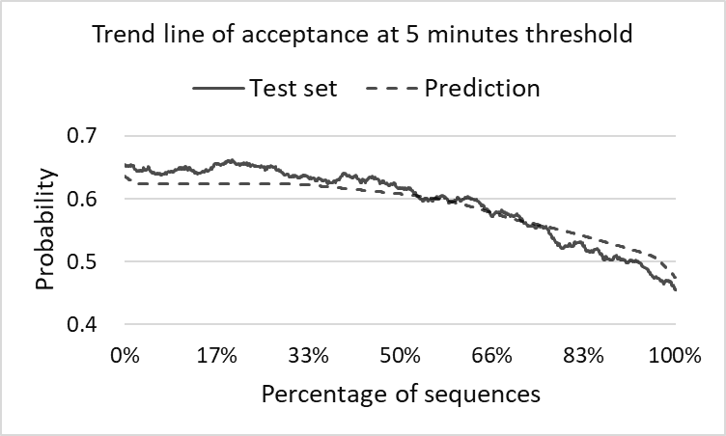
5. Result and Discussion
Evaluation of prediction
Evaluation of 5 minute threshold
High precision
Possible explanation: The threshold of 5 minute is a commonly acceptable walking duration, some one who cannot accept this threshold can be considered to have some particular characteristics. The features are significant at this threshold.

Slide 69
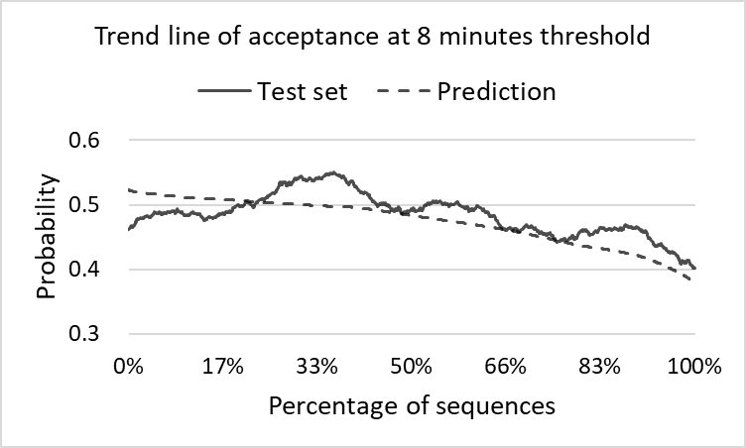
5. Result and Discussion
Evaluation of prediction
Evaluation of 8 minute threshold
Low precision
Possible explanation: There may be some randomness in making the decision of whether walking to transit stations at the 8 minutes threshold. People may have some ambiguity in choosing whether to accept or not. The features are not significant at this threshold.

Slide 70
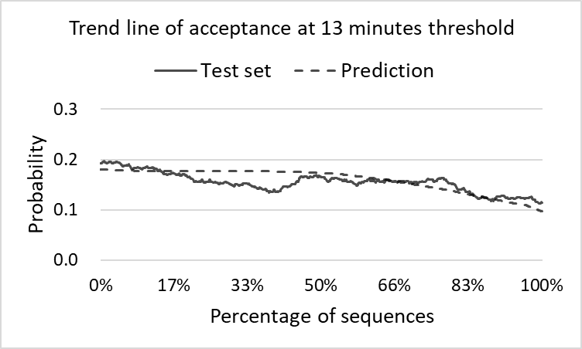
5. Result and Discussion
Evaluation of prediction
Evaluation of 13 minute threshold
Slightly high precision
Possible explanation: The threshold of 13 minute is not a commonly acceptable walking duration, some one who can accept this threshold can be considered to have some particular characteristics. The features are significant at this threshold.

Slide 71
6. Conclusion
Superior Topic
Exploring the use tendencies of urban rail transit
Application of this achievement
PSDC data in the blocks (e.g. A/B/C)
input
A
5 min
8 min
B
Model
13 min
Station
The trend (probability) of using this station in the blocks can be grasped.
Block
C
output
Achievement in this study
Probability of accepting the given threshold of walking duration

Slide 72
END

Slide 73
Title
Sub Title
1
Second-level Title
Third-level Title
Item
1
Item with sequence
Footnote
Font
Main body: English (Times New Roman)
Japanese (MS Mincho)
Title: English (Arial)
Japanese (Yu Gothic)
Word Size
Table : 12pt~14pt
Main body : 18pt (Sometimes 16pt)
Footnote : 16pt

Slide 74
The next of this plan
How to use the result of travel pattern for determining the catchment area of stations?
Evaluate the acceptability of accessing to the station based on the attribute and distribution of populations, which can be obtained from census data.
Not effective catchment area
Effective catchment area
A little far
Low proportion of elderly
High proportion of commuter
Not too far
High proportion of elderly
Low proportion of commuter

